Slide 1
Wharton Business and Financial Modeling Capstone
Portfolio Performance Presentation
Long Gu
4/22/2020

Slide 2
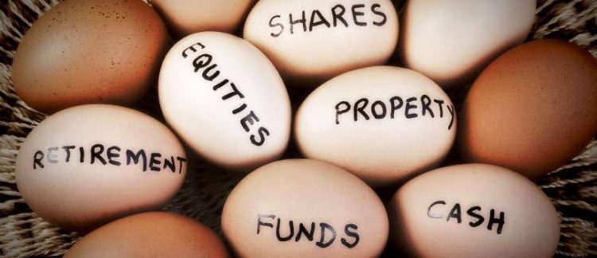
Project Purpose
Use simple example to demonstrates the importance of portfolio diversification
Portfolio (VBTLX & VFIAX) vs Single Security (AAPL)
VBTLX: Vanguard Total Bond Market Index Fund
VFIAX: Vanguard 500 Index Fund Admiral Shares
AAPL: Apple Inc.

Slide 3
Data and Data Source
VBTLX, VFIAX, and AAPL’s Monthly Return From Jan-2012 (Train)
To Jul-2016 (Test)
Data Source
Date | VBTLX | VFIAX | AAPL
Jan-12 | 0.88% | 4.47% | 0.61%
Feb-12 | -0.04% | 4.32% | 0.87%
Mar-12 | -0.57% | 3.29% | 0.47%
Apr-12 | 1.15% | -0.63% | -0.09%
May-12 | 0.96% | -6.01% | -0.03%
Jun-12 | 0.04% | 4.12% | 0.06%
Jul-12 | 1.39% | 1.38% | 0.22%
Aug-12 | 0.04% | 2.25% | 0.40%
Sep-12 | 0.12% | 2.58% | 0.03%
……
Jan-16 | 1.44% | -4.97% | -0.13%
Feb-16 | 0.67% | -0.14% | 12.72%
Mar-16 | 0.95% | 6.78% | -13.99%
Apr-16 | 0.39% | 0.39% | 7.18%
May-16 | 0.02% | 1.79% | -4.27%
Jun-16 | 1.94% | 0.26% | 9.01%
Jul-16 | 0.65% | 3.68% | 1.77%

Slide 4
Efficient Frontier and CML - Portfolio
Optimal Risky Portfolio
Weight_VBTLX | Weight_VFIAX | Risk Free Rate | Fund
81.86% | 18.14% | 0% | $ 5,000,000.00
Stock | Return | Risk | Sharpe Ratio
Portfolio | 0.36% | 0.01% | 54.0
 | VBTLX | VFIAX
mean | 0.17% | 1.24%
stdv | 0.80% | 2.99%
Covariance | -0.0000174
Using excel solver and plotting out the
Efficient Frontier
Capital Market Line
We can easily visual the optimal return of this portfolio is 0.36% at
Weight-VBTLX = 81.86%
Weight-VBFLAX = 18.14%

Slide 5
Comparison – Portfolio vs Single Stock
Gain/Loss ($)
Date | Portfolio | AAPL
Jan-16 | $ 13,849.69 | $ (6,437.84)
Feb-16 | $ 26,224.27 | $ 635,234.26
Mar-16 | $ 100,915.19 | $ (788,488.23)
Apr-16 | $ 19,893.57 | $ 302,272.53
May-16 | $ 17,124.97 | $ (226,193.64)
Jun-16 | $ 82,039.38 | $ 429,942.24
Jul-16 | $ 60,971.86 | $ 95,874.82
Total | $ 321,018.93 | $ 442,204.15
After getting the optimal weight of the portfolio from 2012 – 2015 data and then plug them into 2016 for testing, we found:
Total Gain ($): Portfolio < Single
Actual Return: Portfolio > Single
Actual Risk: Portfolio < Single
Sharpe Ratio: Portfolio > Single

Slide 6
Findings
Gain/Loss ($)
Date | Portfolio | AAPL
Jan-16 | $ 13,849.69 | $ (6,437.84)
Feb-16 | $ 26,224.27 | $ 635,234.26
Mar-16 | $ 100,915.19 | $ (788,488.23)
Apr-16 | $ 19,893.57 | $ 302,272.53
May-16 | $ 17,124.97 | $ (226,193.64)
Jun-16 | $ 82,039.38 | $ 429,942.24
Jul-16 | $ 60,971.86 | $ 95,874.82
Total | $ 321,018.93 | $ 442,204.15
Based on the data that
Total Gain ($): Portfolio is 27% less than Single
Sharpe Ratio: Portfolio is 231 times the Single
We would recommend that it is safer to diversify your portfolio and in other words: “Avoid putting your eggs in one basket”

Slide 7
Limitations of the Sharpe Ratio
The main problem with the Sharpe ratio is that it is accentuated by investments that don't have a normal distribution of returns. Asset prices are bounded to the downside by zero but have theoretically unlimited upside potential, making their returns right-skewed or log-normal, which is a violation of the assumptions built into the Sharpe ratio that asset returns are normally distributed.

